Slide 1
Run your .NET code everywhere with Xamarin.Forms
Alejandro Ruiz
Microsoft/Xamarin MVP
alejandro@alejandroruizvarela.com

Slide 2


Slide 3
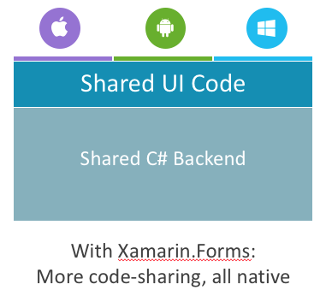
What is Xamarin.Forms?
Xamarin.Forms exposes a complete cross-platform UI toolkit for .NET developers. Build fully native Android, iOS, and Windows apps using C# in Visual Studio.

Slide 4
Why Xamarin.Forms?
Support C# & F#
It’s native
Quick prototyping
Always the latest language and platform features
Active updates
nuget support
lot of community open source code and plugins
Share a lot of code(UI / Core)

Slide 5

Write Everything in C#
C# Now Runs on 2.6+ Billion Devices

Slide 6

Supported Platforms
iOS
Android
UWP
Tizen
Starting on Xamarin.Forms 3
MacOS
WPF
WebAssembly
GTK

Slide 7
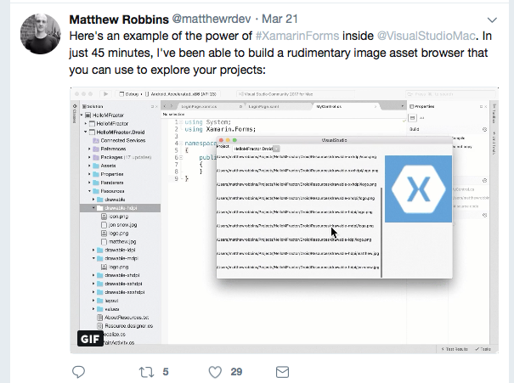
Much more…
IoT
Visual Studio Extensibility

Slide 8
Let's see Xamarin.Forms in action

Slide 9

Open Source – open.xamarin.com

Slide 10
Questions?
Alejandro Ruiz
Microsoft / Xamarin MVP
Run your .NET code everywhere with Xamarin.Forms
Demo Code: https://github.com/AlejandroRuiz/XamarinForms3Demo
alejandro@alejandroruizvarela.com
http://alejandroruizvarela.blogspot.com
https://github.com/alejandroruiz
@alejandroruizva

